Slide 1
Lesson 3 Adding More Controllers
BY
Aneesh Kumar

Slide 2
INDEX
Creating Registration.js Model
Creating RegistrationController
Creating ApprovalController
Creating RejectionController
USE POSTMAN FOR SEND REQUEST

Slide 3
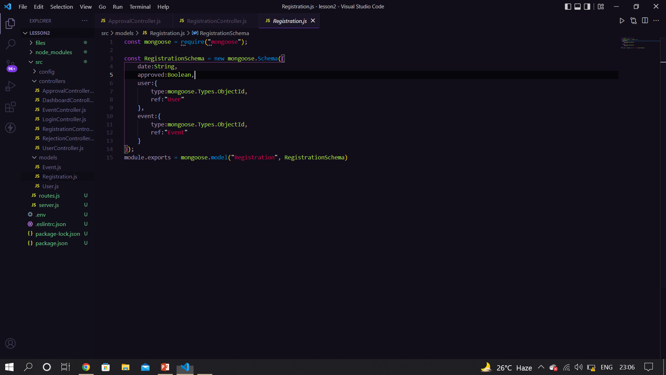
Create Registration.js file

Slide 4
Registration.js explanation
In the models folder we create Registration.js file .
We create different fields like date approved and user and event reference.
After that we are export that other side .

Slide 5
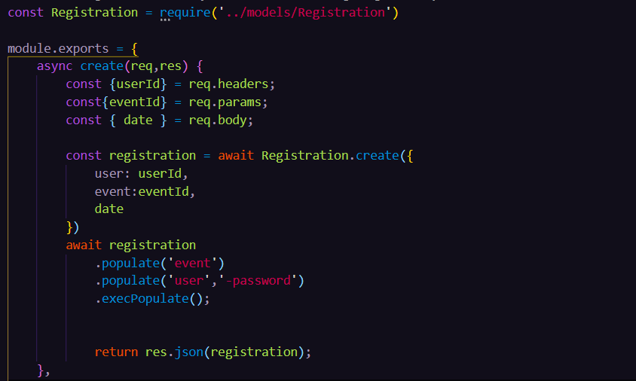
Create RegistrationController.js file

Slide 6
Explanation of RegistrationController.js
With the help of create method(), we are inserting an user_id , eventId and date .
Date property is used for knowing on which date we are to register an event .
First we create event to receive all the information form the request.
Then we apply findById() method to create user and check it using User_id.
If the user is exist then it create a event or if not exist then it show a massage user is not exist.

Slide 7
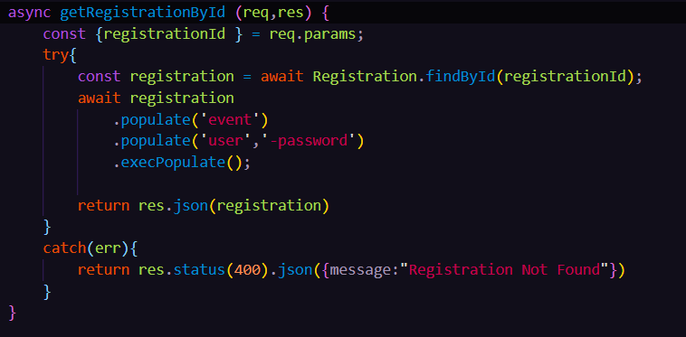
Create RegistrationController.js

Slide 8
Explanation of RegistrationController.js
In the RegistrationController.js file we are control or call the register sub file.
First we export the module and fetch that user is exist on the database or not if exist then show a massage user is exist and if not exist then create a new user using user schema.
After that we use getRegistrationById()method and use the User_id and fetch the user is exist on database or not if exist it show the result and not then 400 error massage show.

Slide 9
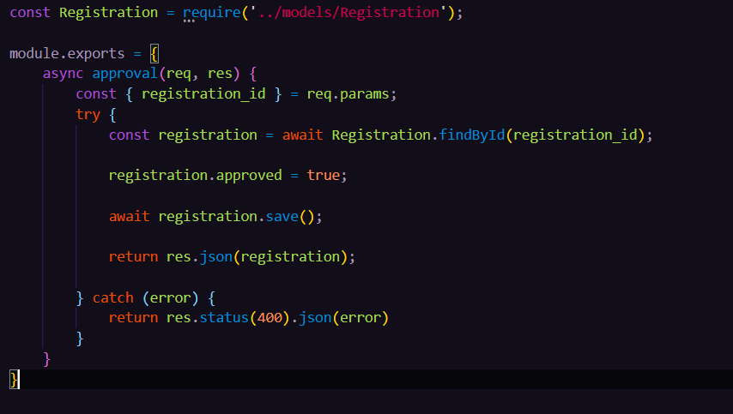
Create ApprovalController.js

Slide 10
Explanation of ApprovalController.js
In the Approval.js file we are importing the Registration.js file .
First we export the module and then we have controller approval.
We are the fetching the registeredId and then making the approve field (Boolean value) to be true.

Slide 11
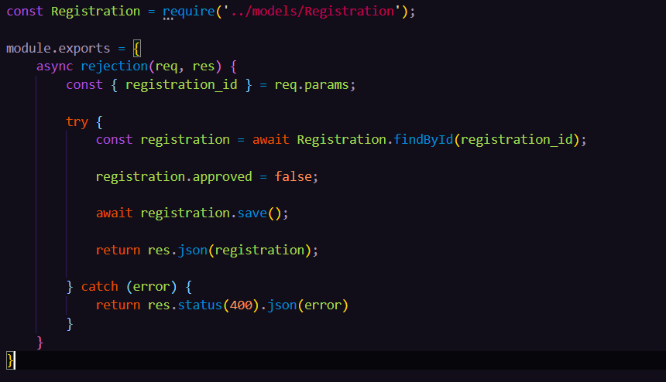
Create RejectionController.js

Slide 12
Explaination of RejectionController.js
In the Rejection.js file we are importing the Registration.js file .
First we export the module and then we have controller approval.
We are the fetching the registeredId and then making the approve field (Boolean value) to be false.

Slide 13
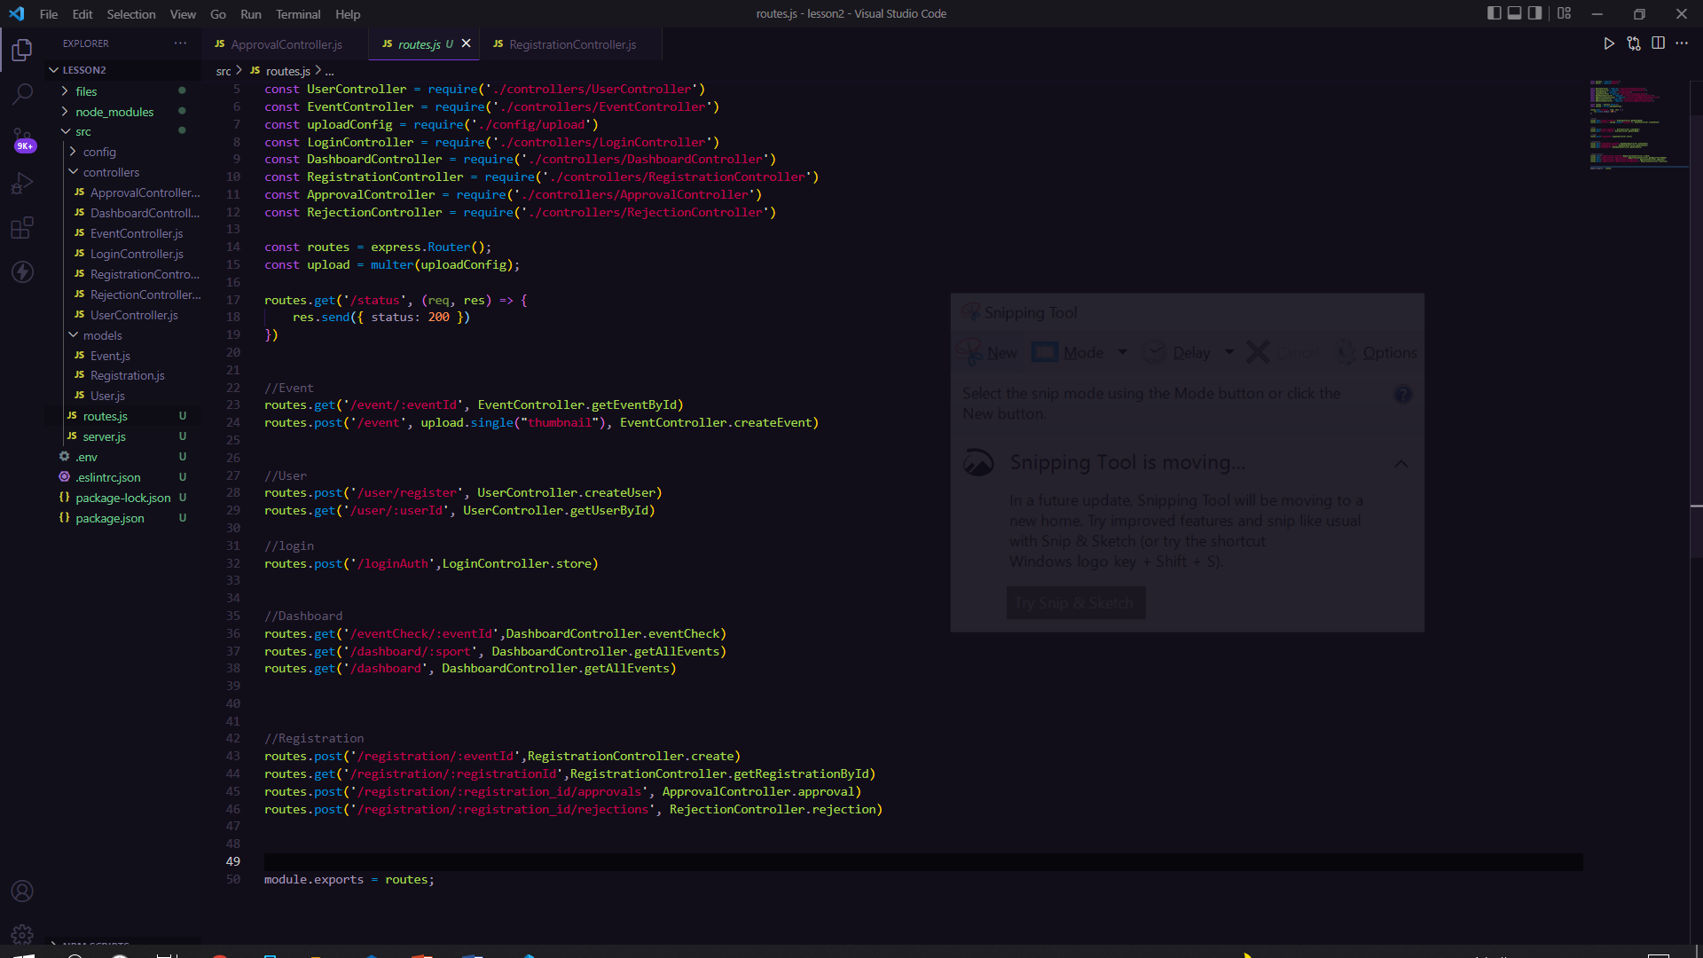
Updated routes.js

Slide 14
Explanation of routes.js
In the routes.js file we are connected all the middleware that are routes of the main file .
And also create the user and event routes that we call through an API.

Slide 15
Use Postman to check request
How we use POSTMAN
Step 1:- Go to the collection tab click on the ‘+’ button create a new collection it will appear name or other setting.
Step 2:- Then select create a new request and it will open a window on post man application like this.
Step 3 :- Set the address of your local host and add the request type get and check the result. If it shows status code 200 in green then it is ok.
Step 4 - Set post request and put the value and check the status if it show 200 then it’s ok or if show 404 then error is process.

Slide 16
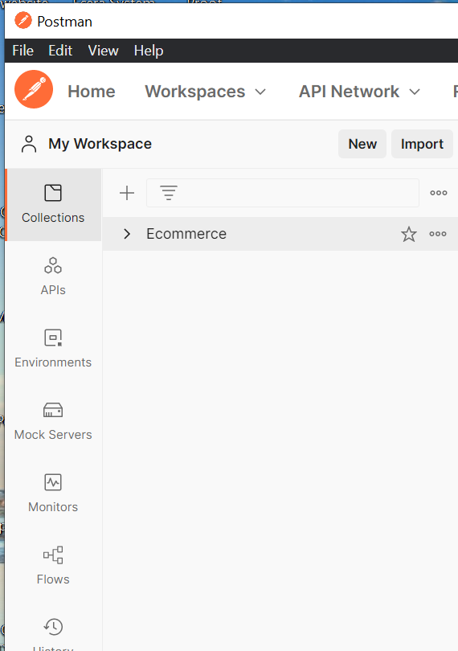
Process step of postman

Slide 17
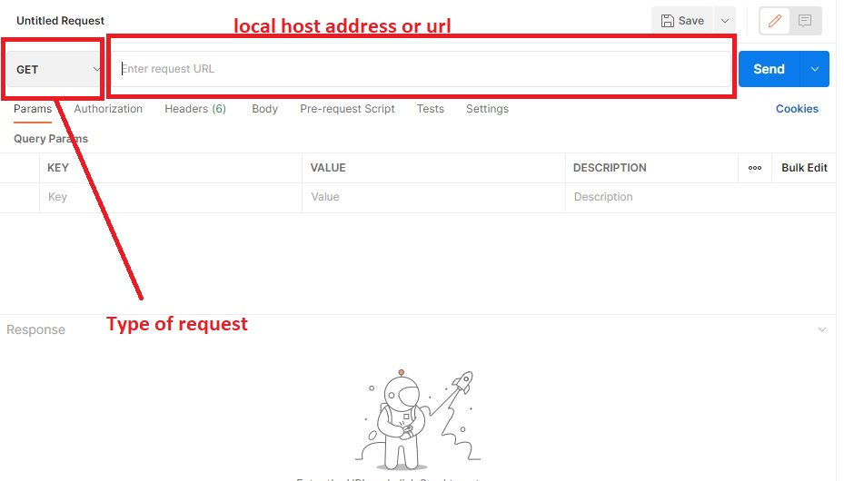
Process step of postman

Slide 18
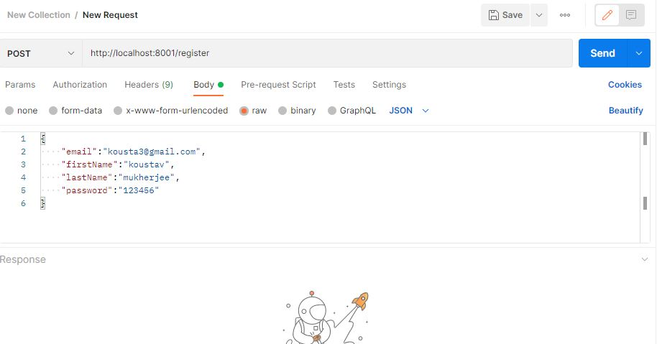
Process step of postman using register

Slide 19
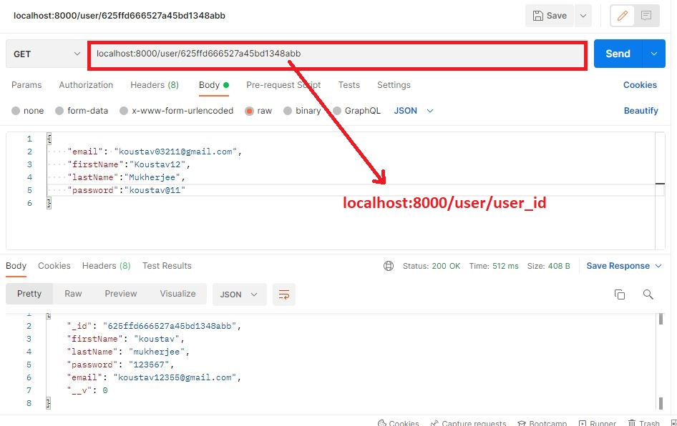
Process step to fetch data using get method by user_id

Slide 20
Create an event using postman
Step 1-> select method POST and add url
Step 2-> Go to body and select form-data and fill-up all data like title, date, description it is fill as text and select and filled like thumbnail change it to text to file from the postman hidden button and after that select the file.
Step 3 -> go to send button to send the request.
Step 4 -> change the request GET and then search a event by event _ id .

Slide 21
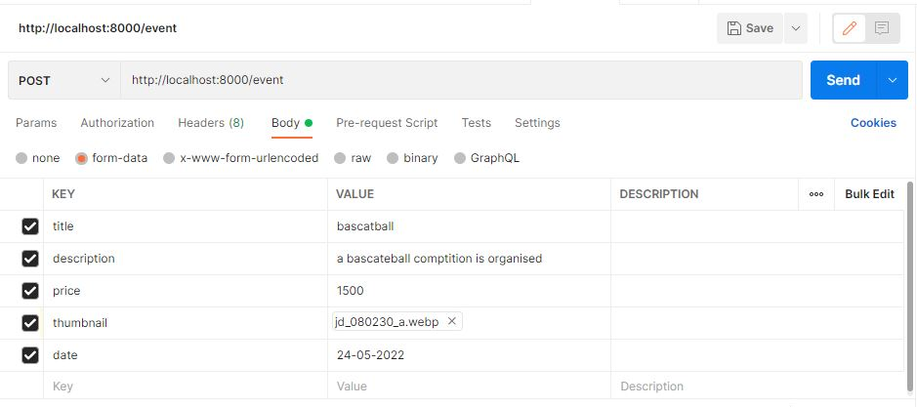
Process step of postman using event

Slide 22
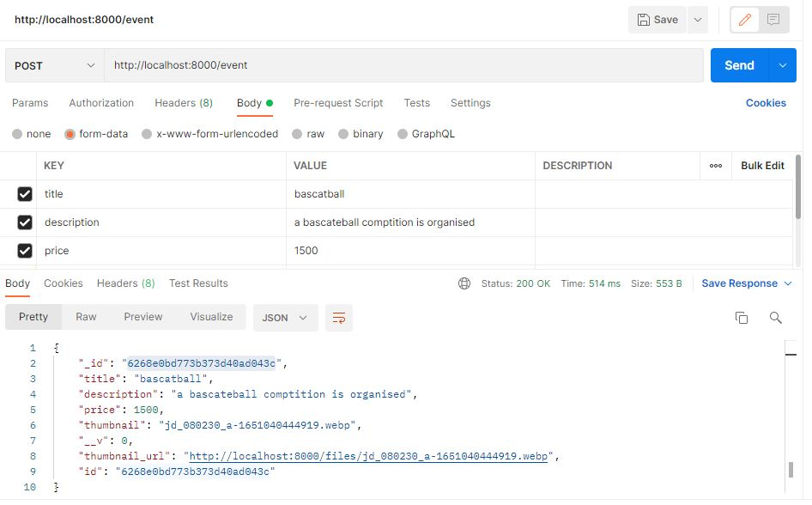
Process step of postman using event(click on send button and see result

Slide 23
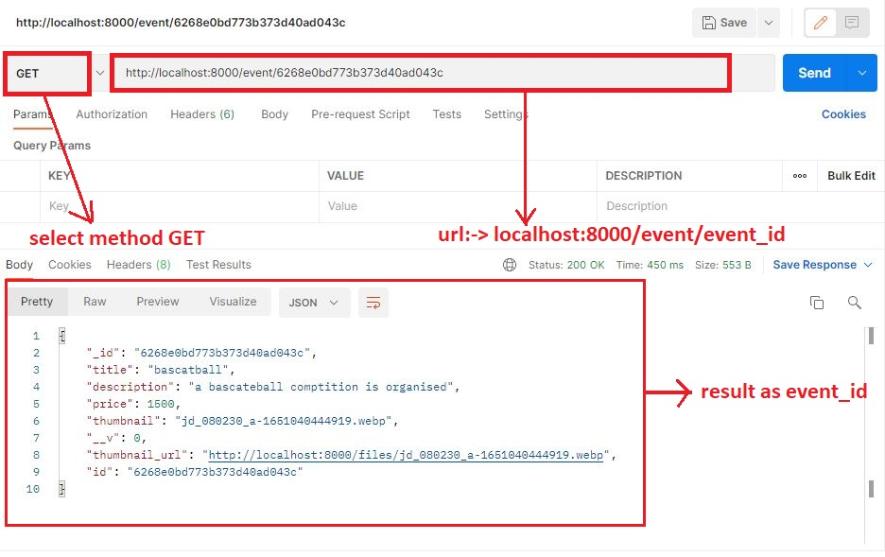
Process step to fetch data using get method by event_id

Slide 24
Thank You

